Slide 1

Make Simple Tasks Simple!
Bjarne Stroustrup
Morgan Stanley Columbia University, Texas A&M University
www.stroustrup.com

Slide 2
Abstract
C++ faces two challenges:
Help programmers address the most demanding tasks in terms of performance, scale, and dependability
help programmers be productive writing ordinary maintainable code
There is much more “ordinary code” than there is performance-critical code. Thus, C++ must make simple tasks simple while not getting in the way of tuning software for the last byte and last cycle where that’s necessary. This talk focuses on what C++11 and C++14 offers to simplify programming: auto, range-for loops, move semantics, concepts, and more. However, the focus is not primarily on language features: the key is programming: how can we write better, more readable, efficient, and more maintainable code? If you think that the essence of C++ is clever pointer manipulation and huge class hierarchies you may be in for a few surprises.

Slide 3
Executive Summary
Keep simple things simple
Don’t make complex things unnecessarily complex
Don’t make things impossible
Constraint: Don’t sacrifice performance
C++ is expert friendly
and becoming more so
C++ must not be just expert friendly
Serving novices and “occasional users” is very important
Most of the time, I don’t want to be a language lawyer

Slide 4
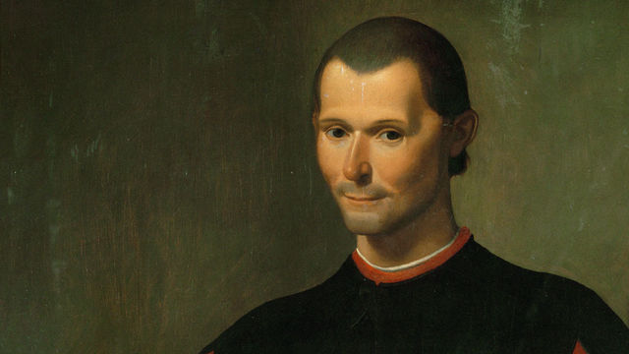
… there is nothing more difficult to carry out, nor more doubtful of success, nor more dangerous to handle, than to initiate a new order of things. For the reformer makes enemies of all those who profit by the old order, and only lukewarm defenders in all those who would profit by the new order …
We are heavily invested in C++98 code, techniques, and tools, so …

Slide 5
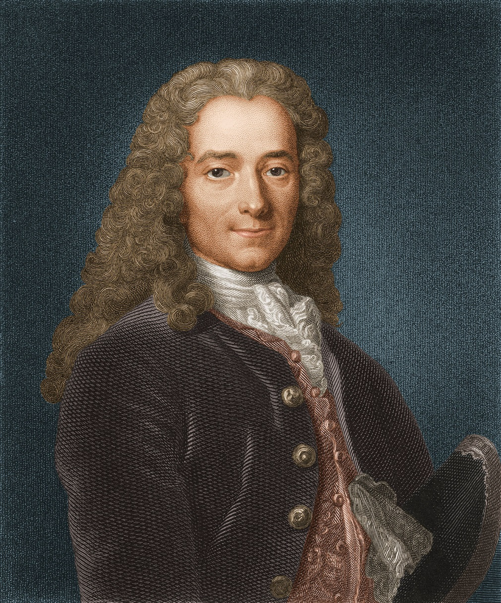
“The best is the enemy of the good.”
Clever programmers like clever code
Language enthusiasts like advanced features

Slide 6
Overview
Preamble
What is “simple”?
Loop example
Resource example
Generic programming is (just) Programming
What next?

Slide 7
Being too clever is not clever
BWK (1976)
“debugging is twice as hard as writing the program in the first place. So, if you’re as clever as you can be when you write it, how can you debug it?”
Design for clarity
Essential complexity
What is needed to defeat to solve the problem
Try to find the simplest solution
Accidental complexity
introduced by the expressions of the solution
Minimize it by using C++ well
Don’t over-abstract
Base generalizations on concrete solutions
Hide complexity
Good interfaces are essential

Slide 8
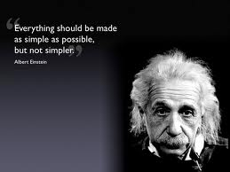
Make simple things simple!
What does “simple” mean?
Make the code directly express intent
Simple code is easier to understand
Simple code is often beautiful
Simple code is often fast
Not all code can be simple
Hide the complexity behind a simple interface

Slide 9
“Simplify” is not a new idea in C++
The (1979) traditional style
X x; // uninitialized
… // don’t use x here
init(x); // make x ready for use
… // don’t init(x) here
cleanup(x);
… // don’t use x here
… // don’t use cleanup(x) here
1979 (paraphrased using modern terminology):
A constructor establishes the run-time environment for member functions (incl. acquiring the resources needed) aka establish invariant
A destructor reverses the action of the constructor (incl. releasing any resources owned)

Slide 10
Make simple things simple!
A modern (post 1979) use: { X x; … }
A constructor/destructor pair
makes the programmer’s intent explicit
eliminates some classes of errors
Use before initialize
Double initialization
Double destruction
Creates a couple of new problems
How to report failure to construct?
=> exceptions
How to avoid double destruction when people use new/delete?
=> GC? (no)
smart pointers (and problems with managing ordinary pointers)
Avoid “naked” new/delete

Slide 11

Loops

Slide 12
Loop example
A simple example from a friend
A production code example reduced to its essentials
Good production code
// old code:
std::vector<MemoryBuffer>::const_iterator cit = MemVec.cbegin();
for ( ; cit != v.end(); ++cit) {
if (LookForPattern(*cit))
return true ;
}
return false;

Slide 13
Loop example
Use auto
the oldest C++11 feature
Put the for-initializer into the loop where it belongs
// first step:
for (auto cit = MemVec.cbegin(); cit!=v.end(); ++cit) {
if (LookForPattern(*cit))
return true ;
}
return false ;

Slide 14
Loop example
Convert to a range-for loop
We do not know we have a regular loop
No “fiddling” with the iterator
// second simplification:
for (const auto& x : v)
if (LookForPattern(x))
return true ;
return false ;

Slide 15
Loop example
“Obviously” we should have used an algorithm
It was not obvious to good programmers at the time
Not all loops reduce to a standard-library algorithm
// good:
return find_if(cbegin(v), cend(v), LookForPattern) != cend(v) ;

Slide 16
Loop example
I’m tired of writing v.begin(),v.end()
It’s general, but
It exposes implementation
Use a container/range algorithm
// my variant:
return find_if(v,LookForPattern)!=cend(v);

Slide 17
Loop example
A container/range algorithm
Maybe you just happen to have one lying around
It should be part of the standard library
There is a TS for such simplifications
// range version of std::find_if:
template<typename Cont, typename Pred>
Iterator<Cont> find_if(Cont& c, Pred p)
{
return std::find_if(begin(c),end(c),p);
}

Slide 18
Loop example
What is Iterator<Cont>?
A template alias
Should be standard
// my variant:
template<typename T>
using Iterator = typename T::iterator;

Slide 19
Loop example
Question
What would you have said if I five years ago had promised that you could halve the size of that code?
Answer
Snake oil!
Fact
That code is in production today
Incremental improvement can get us a long way
Progress happens

Slide 20
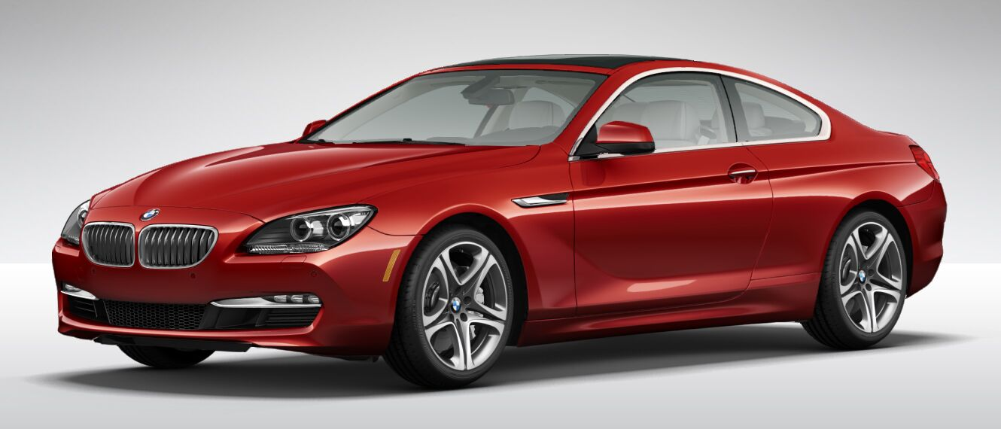
Resource Management

Slide 21
Resource management example
Collect copies of elements (C++98 style)
vector<string>* collect_s(char ch)
// copy words staring with ch from cin
{
vector<string>* p = new vector<string>;
string s;
while (cin >> s)
if (s[0] == ch)
p->push_back(s);
return p;
}

Slide 22
Resource management example
Collect copies of elements (C++98 style)
Remember to delete
Use pointer notation
void use1()
{
vector<string>* strings = collect_s('s');
// ... usage: (*strings)[n] …
delete strings;
}

Slide 23
Resource management example
Collect copies of elements (naïve C++11 style)
Use smart pointers to eliminate leaks
void use2()
{
shared_ptr<vector<string>> strings {collect_s('s')};
// ... usage: (*strings)[n] …
// delete strings;
}
void use3()
{
unique_ptr<vector<string>> strings {collect_s('s')};
// ... usage: (*strings)[n] …
// delete strings;
}

Slide 24
Resource management example
Return container by value
Rely on move constructors
vector<string> collect(char ch)
// copy words staring with ch from cin
{
vector<string> res;
for (string s; cin >> s; )
if (s[0] == ch)
res.push_back(s);
return res;
}

Slide 25
Resource management example
Return container by value
Rely on move constructors
No pointers and no leaks
No pointer notation
void use4()
{
auto strings = collect('s') ;
// ... usage: strings[n] …
}

Slide 26
Resource management example
Generalize
Still return by value
template<typename Iter, typename Predicate>
vector<Value_type<Iter>> collect(Iter first, Iter last, Predicate pred)
// copy elements that meets pred() from [first:last)
{
vector<Value_type<Iter>> res;
for (auto p = first; p!=last; ++p)
if (pred(*p))
res.push_back(*p);
return res;
}

Slide 27
Resource management example
Generalize
Test with a variety of sequences, element types, and predicates
bool odd(int x) { return x % 2; }
void test()
{
auto lst = { 1, 2, 3, 4, 5, 6 };
auto ss = collect(begin(lst), end(lst), odd); // {1,3,5}
}

Slide 28
Resource management example
Generalize
Test with a variety of sequences, element types, and predicates
bool initial_s(const string& s) { return s.size() && s[0]=='s'; }
void user6()
{
auto strings = collect(istream_iterator<string>{cin},
istream_iterator<string>{},
initial_s);
}

Slide 29
Resource management example
I still like range/container algorithms
template<typename Sequence, typename Predicate>
vector<Value_type<Sequence>> collect(Sequence seq, Predicate p)
{
vector<Value_type<Sequence>> res;
for (const auto& x : seq)
if (p(x))
res.push_back(x);
return res;
}

Slide 30
Resource management example
I still like range/container algorithms
And lambda expressions can be useful
void user()
{
// auto ss1 = collect({ 1, 2, 3, 4, 5, 6 }, odd); // error: Bummer!
auto lst = { 1, 2, 3, 4, 5, 6 };
auto ss2 = collect(lst, odd); // {1,3,5}
// auto ss3 = collect(cin, initial_s); // error: logically impossible
auto ss4 = collect(Istream_range<string>{cin}, initial_s);
auto is = Istream_range<string>{cin};
auto ss5 = collect(is, [](auto& s){ return s.size() && s[0] == 's'; });
}

Slide 31
Resource management example
We need to throw in a trait
template<typename C>
struct value_trait { using type = typename C::value_type; };
template<typename T>
struct value_trait <T*> { using type = T; };
template<typename T>
using Value_type = typename value_trait<T>::type;

Slide 32
Resource management example
We need a helper class
An istream doesn’t have a value type that we can iterate over
template<typename T>
struct Istream_range {
using value_type = T;
istream& s;
// Istream_range(istream& x) : s{ x }{}
istream_iterator<T> begin() { return istream_iterator<T> {s}; }
istream_iterator<T> end() { return istream_iterator<T>{}; }
};

Slide 33
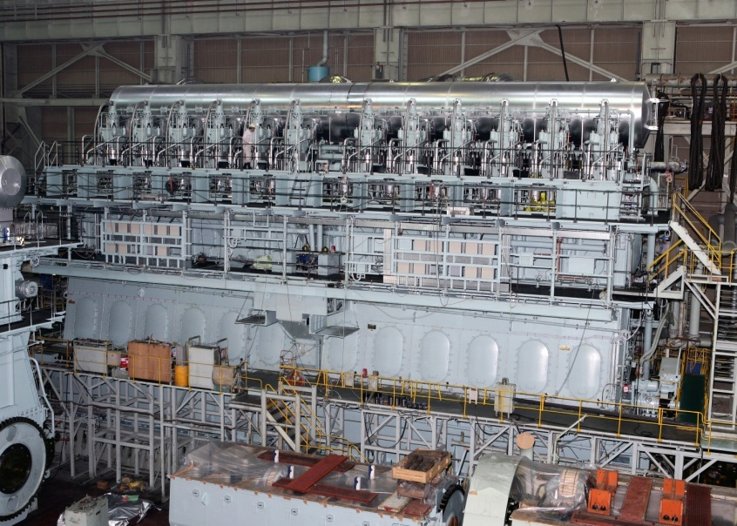
Concepts

Slide 34
Generic Programming
1980: Use macros to express generic types and functions
1987 (and current) aims for templates:
Extremely general/flexible
“must be able to do much more than I can imagine”
Zero-overhead
vector/Matrix/… to compete with C arrays
Well-specified interfaces
Implying overloading, good error messages, and maybe separate compilation
“two out of three ain’t bad”
But it isn’t really good either ☹
it has kept me concerned/working for 20+ years

Slide 35
Templates have problems
“Loud” syntax
template<typename T>
class X { /* clever members and member functions */ };
Many workarounds are needed
Too many classes, too many specializations
The code drowns in “boilerplate”
Odd/different
Syntax
Semantics (compile-time “duck typing”)
Programming style
Error messages are spectacularly bad
No good interfaces
Use of complicated templates can slow compilation

Slide 36
Templates have been successful
Spectacularly so
Widespread use
Influence on many programming languages
We need to
Provide better support
Express intent
Write less code
Allow greater expressiveness
Compile faster
Give better error messages
Make generic programming “ordinary programming”

Slide 37
Remedies
Use constexpr functions if the result is a value
constexpr int fac(int n) { return (n>2) ? n*fac(n-1) : n; }
C++14 allows loops and simple variables in constexpr functions
constexpr makes compile-time computation conventional and type safe
Use variadic templates to deal with “complicated” arguments
C++11
More can be done to simplify: C++17
Constrain template arguments
Simplifies checking
Improves error messages
Enables overloading
Leave template metaprogramming to experts and library implementers

Slide 38
Generic Programming is just Programming
Traditional code
double sqrt(double d); // C++84: accept any d that is a double
int x = 7;
double d2 = sqrt(x); // fine: x can be used as a double
double d3 = sqrt(&x); // error: &x is not a double
Generic code (C++14 + concepts)
void sort(Container& c); // accept any c that is a Container
vector<string> vs { "Hello", "new", "World" };
sort(vs); // fine: vs can be used as a Container
sort(&vs); // error: &vs is not a Container

Slide 39
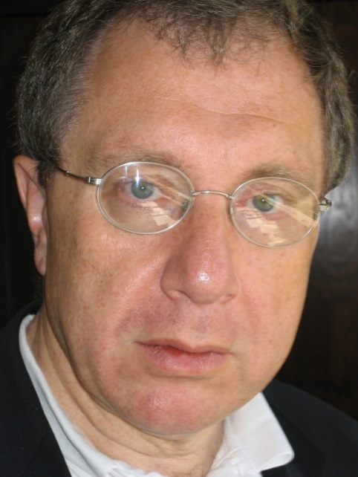
How do we specify requirements for template arguments?
Concepts (aka “concepts lite”)
state intent
Explicitly states requirements on argument types
provides point-of-use checking
No checking of template definitions
are predicates
Boolean constant expressions, incl. constexpr functions
Requirements analysis
Alex Stepanov, Andrew Lumsdaine, Sean Parent, Bjarne Stroustrup, Andrew Sutton, and a couple of dozen more
Design
Bjarne Stroustrup, Andrew Sutton, and Gabriel Dos Reis
Implementation
Andrew Sutton in GCC
TS in its final stages

Slide 40
Concepts
A concept is a predicate on one or more arguments
E.g. Sequence<T> // is T a Sequence?
Template declaration
template <typename S, typename T>
requires Sequence<S> && Equality_comparable<Value_type<S>,T>
Iterator<S> find(S& seq, const T& value);
Template use
void use(vector<string>& vs)
{
auto p = find(vs,"Jabberwocky");
// …
}

Slide 41
Concepts
Error handling is simple (and fast)
template<typename Cont>
requires Sortable<Cont> // Sortable is a Sequence with random access
void sort(Cont& container);
vector<double> vec {1.2, 4.5, 0.5, -1.2};
list<int> lst {1, 3, 5, 4, 6, 8,2};
sort(vec); // OK
sort(lst); // Error at (this) point of use
Actual error message
error: ‘list<int>’ does not satisfy the constraint ‘Sortable’
More information upon request

Slide 42

Concepts
Yes, you can defined your own concepts
They are simply compile-time constant expressions
You can use standard-library type_traits
You can test for valid expressions
requires(C x) { {f(x)}->int; } // you can call f(x) when x is a C // and convert the result to an int
Yes, there is/will be a standard library of concepts
With concepts like Regular, Ordered, Iterator, Container, Number
No, concepts are not base classes
But you can write a concept that requires a particular base class
No, concepts are not Java/C# interfaces
You don’t have to modify types to make them match specifications
No, concepts are not sets of function signatures

Slide 43
Overloading on concepts
But what if we wanted to sort a list?
template<Sortable Cont> // shorthand: Cont is a type that is Sortable
void sort(Cont& container);
template<Sequence Seq>
void sort(Seq& seq) // sort a sequence that doesn’t offer random access
{
vector<Value_type<Seq>> v {begin(seq),end(seq)};
sort(v);
copy(begin(v),end(v),seq);
}
sort(vec); // OK: use sort of Sortable
sort(lst); // OK: use sort of Sequence

Slide 44
Concepts work for lambdas
Gratuitous showoff of lambda “magic”
auto inc1(Number x) { return x+1; } // inc1 increments a Number auto z5 = incr(4);
auto plus = [](Number x) { // nested lambda; see Chris Kohlhepp article
return [](Number y) { return x+y; }
} ;
auto inc4 = plus(4); // inc4 is a function adding 4 to its Number argument
auto z6 = inc4(2); auto z10 = plus(4)(6);
Different people have different ideas of what is simple

Slide 45
auto is the least constrained concept
Gratuitous showoff of lambda “magic”
auto inc1(auto x) { return x+1; } auto z5 = incr(4);
auto plus = [](auto x) { return [](auto y) { return x+y; } };
auto inc4 = plus(4); // inc4 is a function adding 4 to its argument
auto z6 = inc(2);
auto z10 = plus(4)(6);
I proposed auto as an argument type and a return type in 2002
Things take time

Slide 46
Simplify!
Make simple things simple
Don’t make not-so-simple things unnecessarily difficult
We have (general)
template<typename Cont> // introduce Cont as a typename
requires Sortable<Cont> // Sortable is a concept
void sort(Cont& c); // use Cont as an argument type
We can abbreviate (“type of type”)
template<Sortable Cont> // shorthand notation
// Cont is the name of a type that is Sortable
void sort(Cont& c);
We can abbreviate further (“use like a type”)
void sort(Sortable& c); // terse notation
// c is an object of a type that is Sortable

Slide 47
From a language point of view
We can use a concept name as the name of a type than satisfy the concept
void sort(Sortable& c); // terse notation
means
template<Sortable __Cont> // shorthand notation
void sort(__Cont& c);
means
template<typename __Cont> // explicit use of predicate
requires Sortable<__Cont>
void sort(__Cont& c);
Use the notation that’s most appropriate for the complexity of your problem

Slide 48
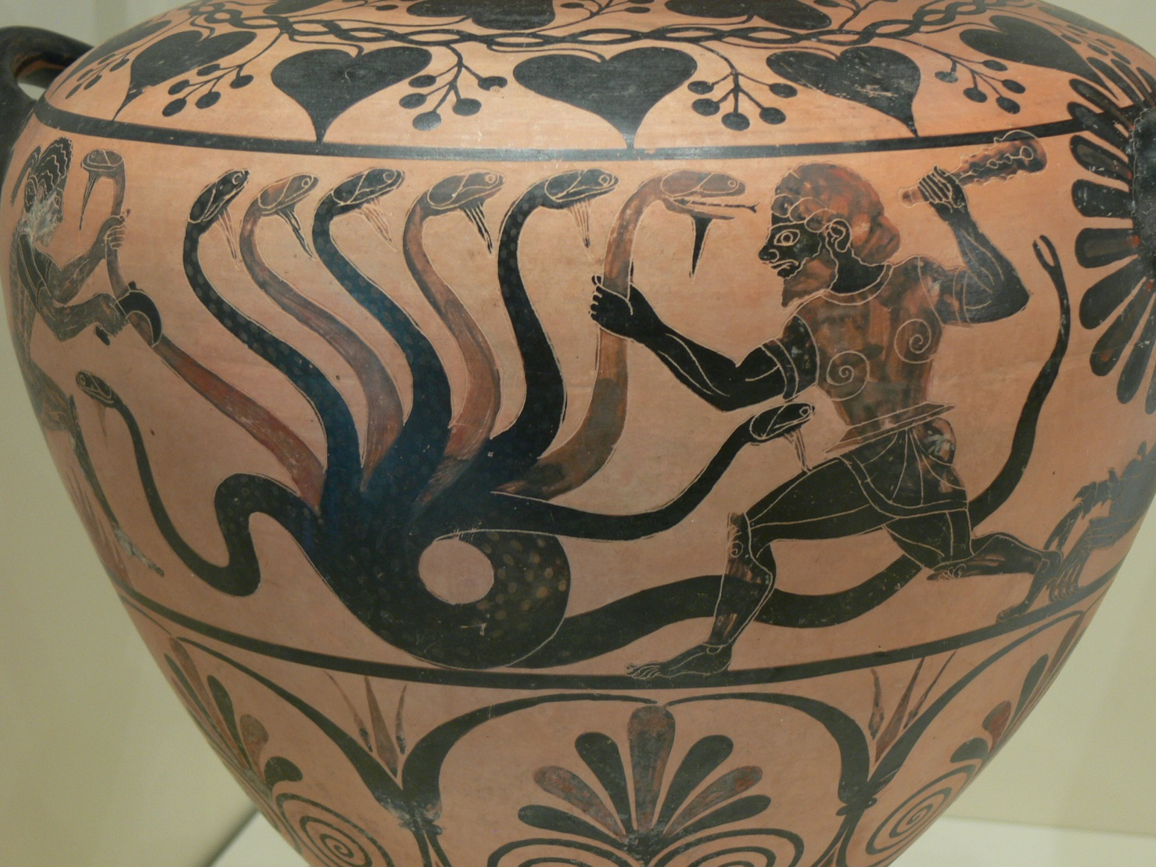
Challenges

Slide 49

Misuse!
The new features allow people to write incomprehensible code!!!
So do old powerful features
“Every powerful new feature can and will be misused” – BS
C’s for statement
virtual functions
templates
Get used to it
Think
Be careful
Learn
Every feature/tool was new once

Slide 50
Pick the low-hanging fruit
Don’t write more complicated old-style code
Avoid the “before examples”
Remove complicated old-style code from your code base
Get “mechanical” help
You’ll find code that’s too messy to simplify “mechanically”
Take the opportunity to fix bugs
Gain credibility before trying something really major
Some of your favorite techniques/theories might not scale
Don’t get fanatical
Much old code works just fine
Try not to be too clever

Slide 51
What if you are not allowed to use C++11/C++14?
Common reasons/rationales
Antique coding standards
Imaginary overheads
Horrible large and messy code bases
“Other programmers” assumed to be too dumb to use the simpler/newer solutions
And the occasional annoying solid technical reason
E.g., linking to code that’s not binary compatible with C++11/C++14
Find a way!
Writing in antique styles implies costs
makes maintenance more difficult
Makes performance worse (sometimes, especially if you have to use older compilers/optimizers)
Annoys good programmers

Slide 52
Design for a (more) ideal language
C++14 + TSs (if you don’t yet have that available)
C++17?
C++20?
Use libraries to simulate desired features
Pattern matching anyone?
www.stroustrup.com/OpenPatternMatching.pdf
Use “formalized comments’’
int area(int h, int w) // precondition: h>0 && w>0
template<typename T> // requires Sequence<T>() && Ordered<Value_type<T>>()

Slide 53
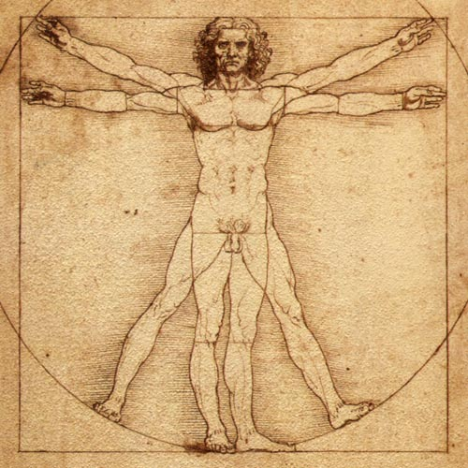
What next?
What should C++ be in 10 years?
Think, think again, build, think again, experiment, think again, lobby
Simplification is hard
Simpler to use
Type and resource safe
Great specialized concurrency models, incl.
Parallel
Physically distributed
Easier to distribute
Easier to compose/link
Faster
More portable
More libraries
Better community

Slide 54
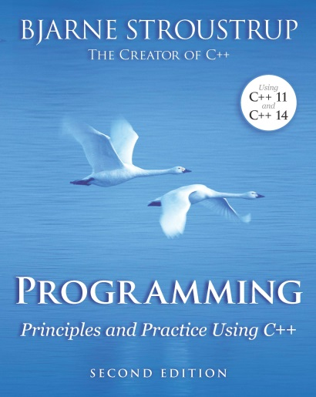
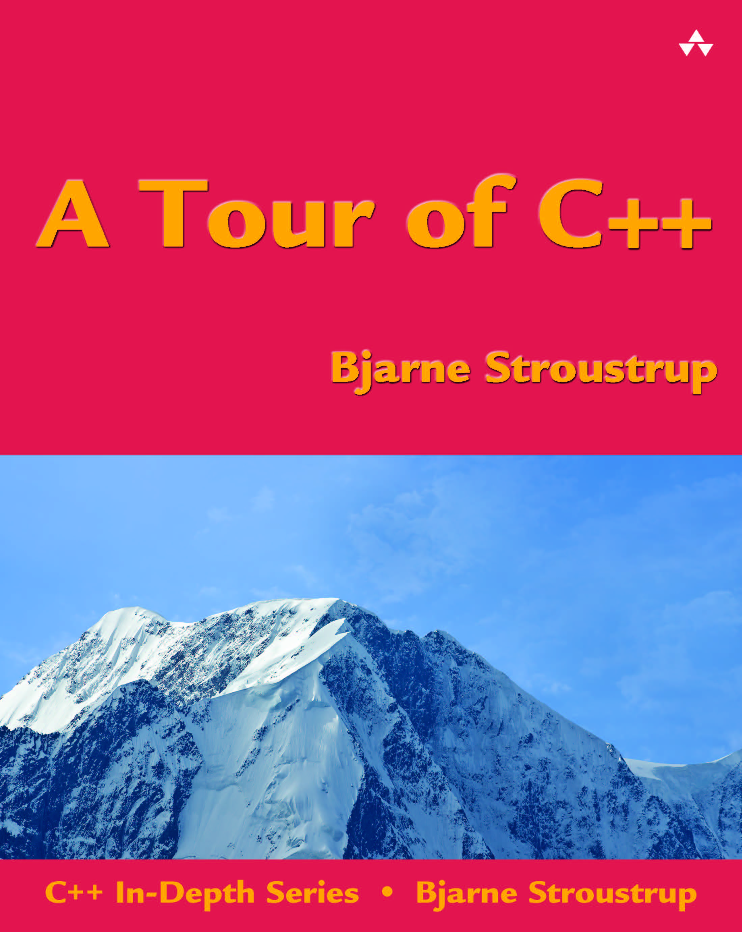
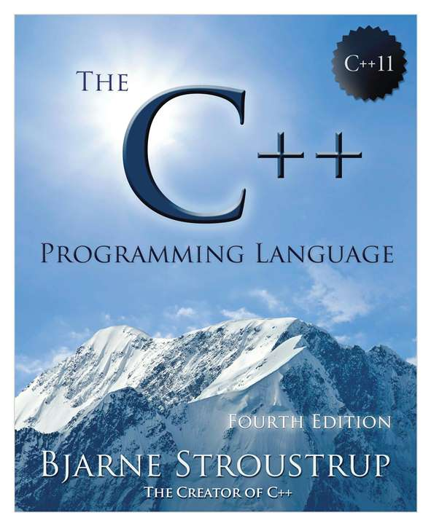
C++ Information
www.isocpp.org
The C++ Foundation’s website
Standards information, articles, user-group information
www.stroustrup.com
Publication list, C++ libraries, FAQs, etc.
A Tour of C++: All of C++ in 180 pages
The C++ Programming Language (4th edition): All of C++ in 1,300 pages
Programming: Principles and Practice using C++ (2nd edition)
www.open-std.org/jtc1/sc22/wg21/docs/papers
The ISO Standards Committee site
The ISO standard: All of C++ in 1,300 pages of “standardese”
All committee documents (incl. proposals)

Slide 55


Questions?
C++: A language for programming with light-weight abstractions
Key strengths:
software infrastructure
resource-constrained applications
Practice type-rich programming
Keep simple things simple

Slide 56
Why is simplification useful?
We can write less code more easily
Why is simplification fundamentally important?
A programming language is the way we express ideas
The more clearly we can state our ideas the better
The more clearly we state our intent, the more the compiler (and other tools) can help us
Correctness
Performance
Our comprehension
Teaching/learning

Slide 57


Slide 58
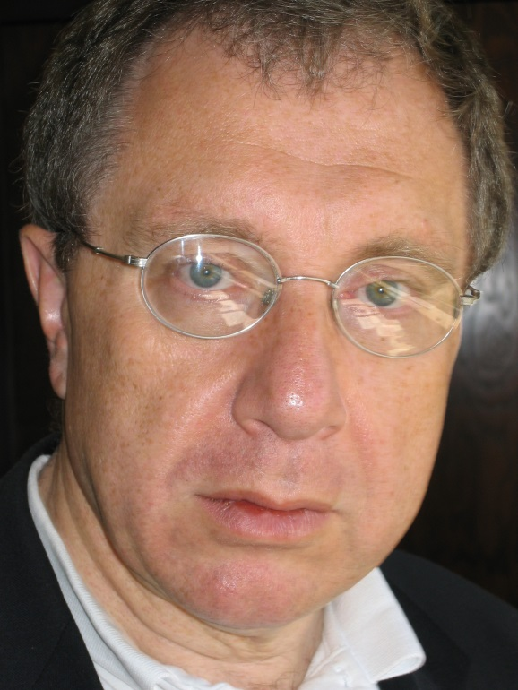

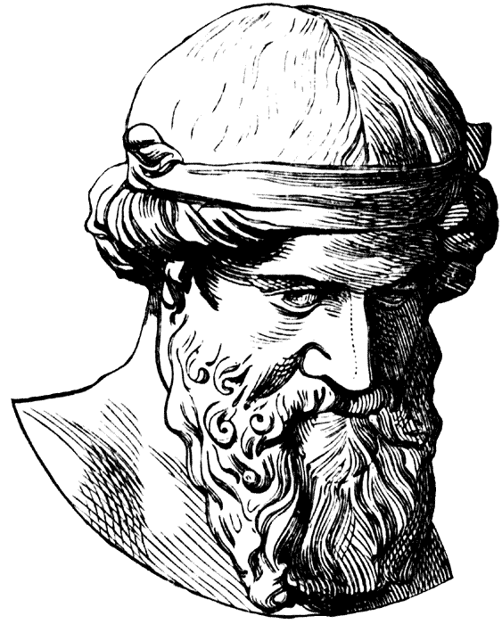
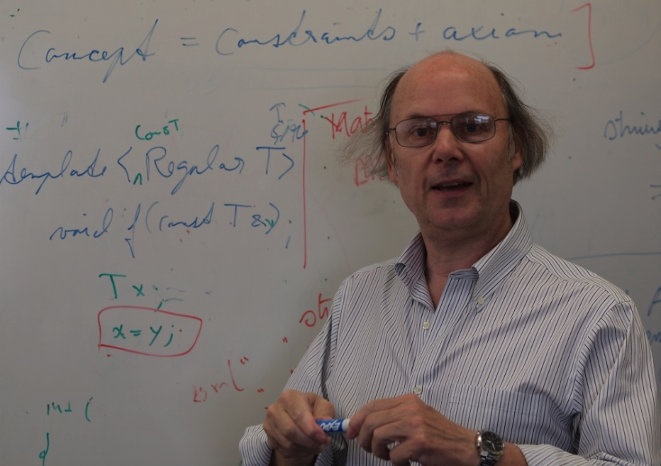

Concepts

Slide 59
Why language/library rather than tools?
State intent
Don’t let a tool guess about it
The language is the programmer’s user interface
Readability is crucial
Don’t be unnecessarily verbose
E.g. , m3 = m1*m2 vs. a nest of loops

Slide 60
Root cause (for good and bad)
Templates provide compile-time “duck typing”
But duck typing is insufficient
There are no proper interfaces
Leaves error detection far too late
Does not integrate well with other parts of the language
We must think of generic code in ways similar to other code
Relying on well-specified interfaces

